Slide 1
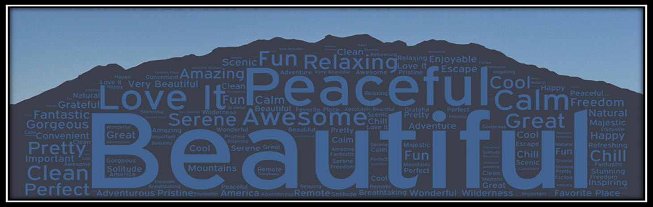
Pleasant Grove Ranger District Visitor Use Study
Steven W. Burr, Ph.D. & Chase C. Lamborn, M.S.
Institute of Outdoor Recreation and Tourism
Utah State University

Slide 2
Utah State University’s
Institute of Outdoor Recreation and Tourism
Research
  Human dimensions of natural resources management
  Wildland recreation on public lands and protected areas
Extension
  1) Tourism and OR in Utah
  2) Community tourism development and management
  3) OR / tourism and public land policy, planning, and management
Education
  Bachelor’s and Master’s degrees in Recreation Resource Management (RRM).
    Distance delivery of undergraduate RRM degree through USU’s Regional Campuses and Centers.

Slide 3
Tonight’s Goal:
Introduce you to the Pleasant Grove Visitor Use Study
  Why the study was conducted.
  How the study was conducted.
  Examine and discuss some of the results.

Slide 4
Why the study was conducted
American Fork Vison.
Search for data.
  National Visitor Use Monitoring (NVUM)—USDA Forest Service.
  Two issues with NVUM:
    Sample size was too small.
    Not all data were applicable to the region and planning efforts.
IORT was approached by Mountainlands Association
of Governments.

Slide 5
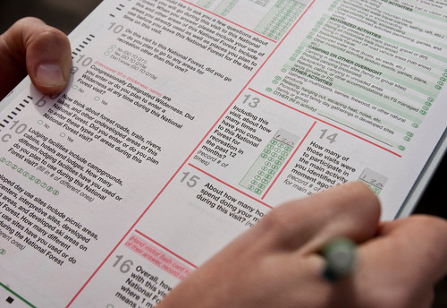
How this study was conducted
This is IMPORTANT!
Survey development
  Collaborative effort.
  NVUM, but more area and issue specific.

Slide 6
How this study was conducted
This is IMPORTANT!
Survey development
  Collaborative effort
  NVUM, but more area and issue specific
Site selection
  Capture the diversity of the area’s geography and utility.

Slide 7
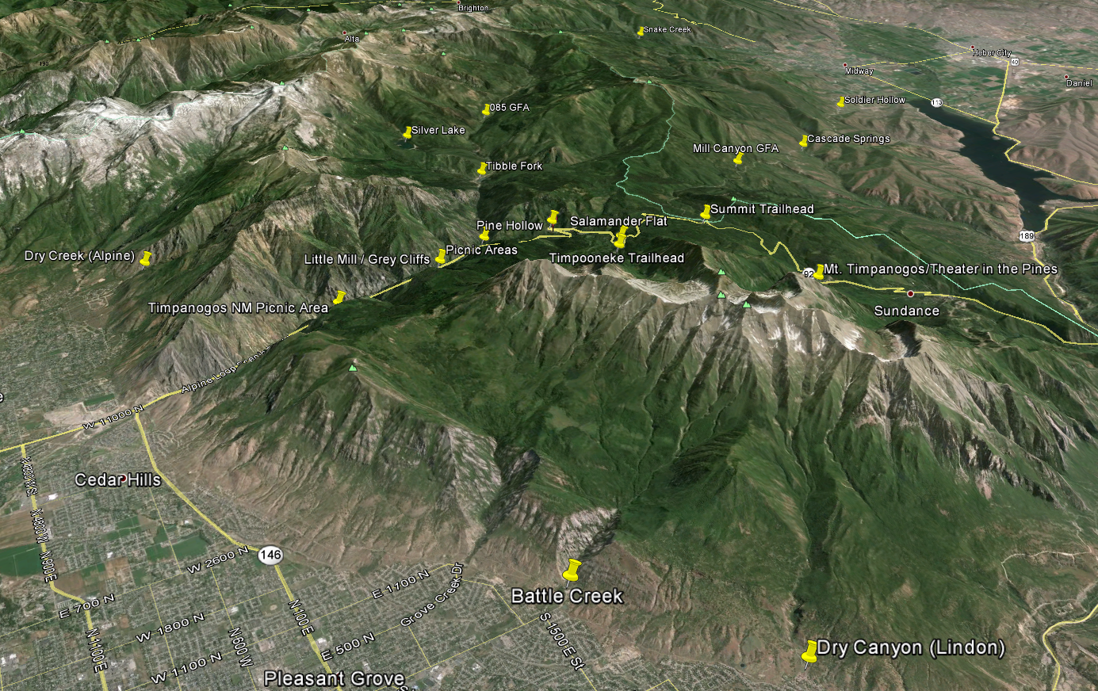

Slide 8
How this study was conducted
This is IMPORTANT!
Survey development
  Collaborative effort
  NVUM, but more area and issue specific
Site Selection
  Capture the diversity of the area’s geography and utility.
Sampling methods
  Generated survey schedules with random dates, times,
  and locations.

Slide 9
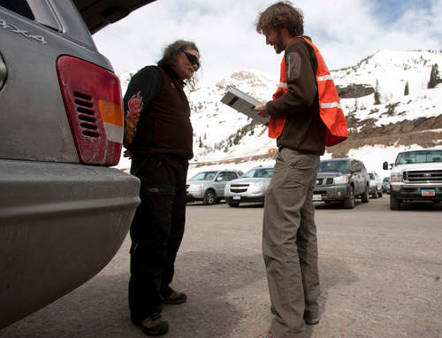

Slide 10
Results
One full year of surveying.
Representative sample for the PGRD.
Completed 1,722 surveys.
Complete 212 follow-up surveys.

Slide 11
Who and How?

Slide 12
Where are visitors coming from?
ZIP codes
Distance from Tibble Fork Reservoir

Slide 13
80% of PGRD visitors live within 40 miles from Tibble Fork Reservoir.
Median = 22 miles
Range = 11 – 2,513 miles

Slide 14
How long are they staying?

Slide 15
78% of respondents only visited one site during their visit.

Slide 16
How often do they visit?

Slide 18
How satisfied are they with their visit?

Slide 20



Top four recreation activities
Hiking (43.1%)
Riding motorized vehicles (10%)
Driving for pleasure (8.2%)
Picnicking (6%)

Slide 21

Top motivating factors for visiting the PGRD
Viewing scenery
Be with friends and family
Experience peace and calm
Exercise

Slide 22
Out-group encounters
See, talk to, interact with, etc.
  Vary greatly given time, location, weather, season, etc.
Number of out-group encounters.
Impact on experience.

Slide 25
Reasons for positive and negative encounters
Reasons for positive encounters
  Friendly
  Helped or shared information
Reasons for negative encounters
  Crowding, noise, etc.
  Motorized use/noise (noise, safety, etc.)

Slide 26
7 people
10 people
6 people
7 people
10 people

Slide 27
Carrying Capacity
Experience correlates with # of encounters
PGRD—10 encounters = 12% negative experiences
Ski resorts—10 encounters = 6% negative experience
Negative experiences are driven by # of encounters AND by the behaviors of other users.
“like minded people”
Expectations
Diversity of use on the PGRD
Influx of people who only visit 1 – 3 times per year
Peak season use same as CWM, but there are more negative encounters on the PGRD.

Slide 28
Should actions be taken?

Slide 30
Landscape and opportunity composition

Slide 31
How do you feel about the current number of developed recreation sites (i.e., campgrounds, picnic areas, etc.)?

Slide 33
Have you ever recreated in congressionally designated Wilderness Areas?

Slide 35
If yes, which ones?

Slide 37
How important are congressionally designated Wilderness Areas to you?

Slide 38
81% said Wilderness was important to them.

Slide 39
Would you support additional Wilderness designations on the PGRD?

Slide 41
Comments
Support Wilderness Designation
Protection (development, Snowbird, OHVs, etc.)
Stipulations
As long as no recreation opportunities were lost
As long as it blocked future development (e.g., Snowbird)
Not support Wilderness Designation
Good balance as is
Restrict access to OHVs and Mt. Bikes

Slide 42
Landscape Composition Summary
Perfect number of developed recreation area.
73% have recreated in congressionally designated Wilderness.
81% say Wilderness is important to them.
77% support additional Wilderness—many had stipulations.
  “as long as it doesn’t cut recreation opportunities.”

Slide 43
Satisfaction and Importance

Slide 44


Satisfaction and Importance
Most satisfied
  Scenery
  Feeling of Safety
  Environmental Conditions
  Helpfulness of FS Personnel
Most important
  Scenery
  Environmental Conditions
  Trail Conditions
  Feeling of Safety

Slide 45

Satisfaction and Importance
Least satisfied
  Cleanliness of Restrooms
  Availability of Parking
  Availability of Recreation Information
  Road Conditions

Slide 47
Not performing
Road Conditions
Environmental Conditions
Availability of Parking
Cleanliness of Bathrooms

Slide 48
Road Conditions
Main issue?
  Safety for themselves, cyclists, and pedestrians.
  “I am always scared I am going to hit a biker!”
  “I think they could widen the road. In some spots two cars passing is very tight and dangerous. Some cars go too fast for conditions and cut into the other lane…I thought we were going to crash…not a very nice drive through the canyon.”

Slide 49
Remedies
Bus or shuttle system?

Slide 50
If public transportation were available, would you have used it today?

Slide 52
Reasons
Why they would have used public transportation.
  Cut down on congested parking.
  Less pollution.
  Save them money on fuel.
Why they would NOT have used public transportation.
  Like driving themselves.
  Not able to bring their gear, dogs, OHVs, etc.
  No control.
  Live so close that it doesn’t make sense.
  Don’t like public transportation and don’t want to see it in the mountains.

Slide 57
Road shoulder should be widened to increase bicycle and pedestrian safety.

Slide 60
Road Conditions Summary
Public Transportation
  Little support
Widening of road shoulders or new bike/walking path.
  Lots of support

Slide 61
Environmental Conditions
2nd in importance and 3rd in satisfaction.
Still room for improvement
Comments
  Littler and trail erosion
Development
Most comments: Snowbird Ski Resort expansion into Marry Ellen Gulch
Not one comment supported this
Majority strongly oppose
Main cause of respondents’ anxiety about declining environmental conditions
Litter, trail erosion, Snowbird

Slide 62
Environmental Conditions Comments
Comments
  Littler and trail erosion
  Development
Most development comments:
  Snowbird Ski Resort expansion into Marry Ellen Gulch
Not one comment supported this
Strongly opposition
Main cause of respondents’ anxiety about environmental conditions

Slide 63
Availability of Parking
2nd lowest in satisfaction
Comments
  Some comments asking for additional parking
  More parking for trailers

Slide 66
Cleanliness of Restrooms
Lowest in satisfaction
Generally low satisfaction
Comments
  More TP
  Clean more often
Cleaning schedule
New strategies

Slide 67
Summary
Overall things are good
  Good balance of opportunities
  People are happy
Some issues
Crowding and Conflict
  Monitor

Slide 68
Summary
Road conditions
  No public transportation; wider road or bike/pedestrian path.
Environmental conditions
  No development.
Parking
  Mild support for additional parking; do not remove informal parking spaces.
Bathrooms
  More TP; cleaning; implement new strategy.

Slide 69
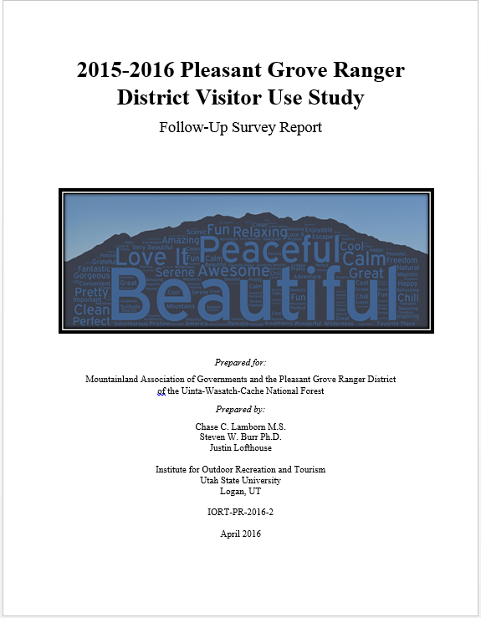
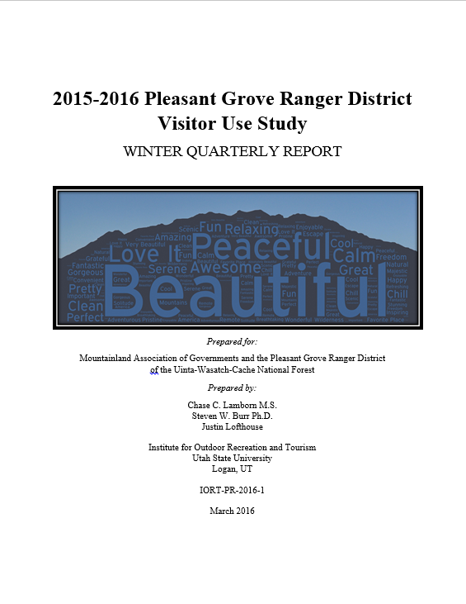
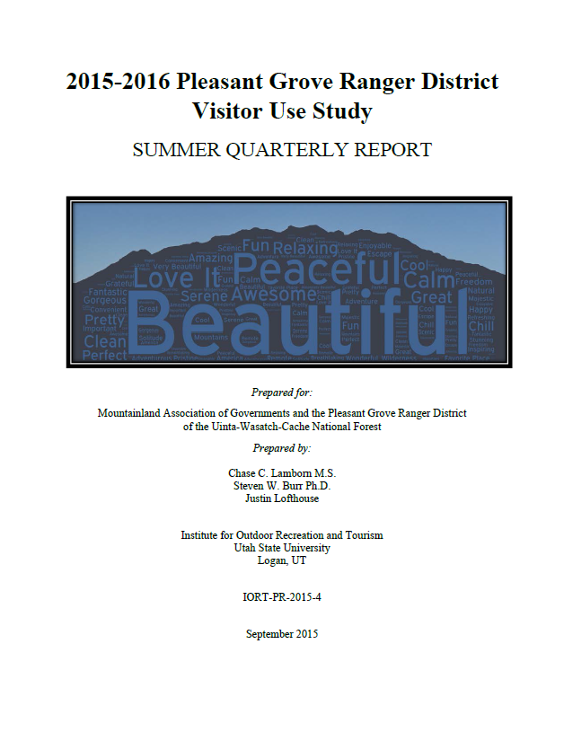
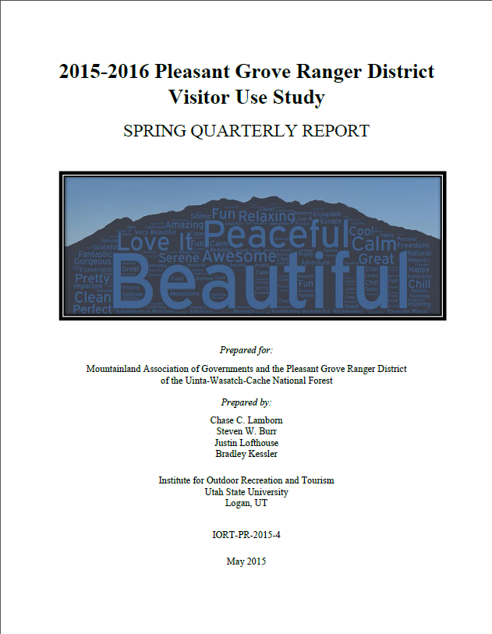
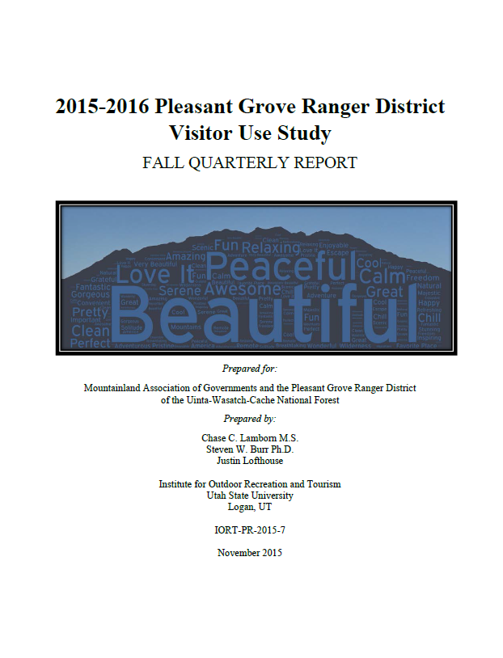
Pleasant Grove Visitor Use Study Reports
Available at our website: https://extension.usu.edu/iort/

Slide 70
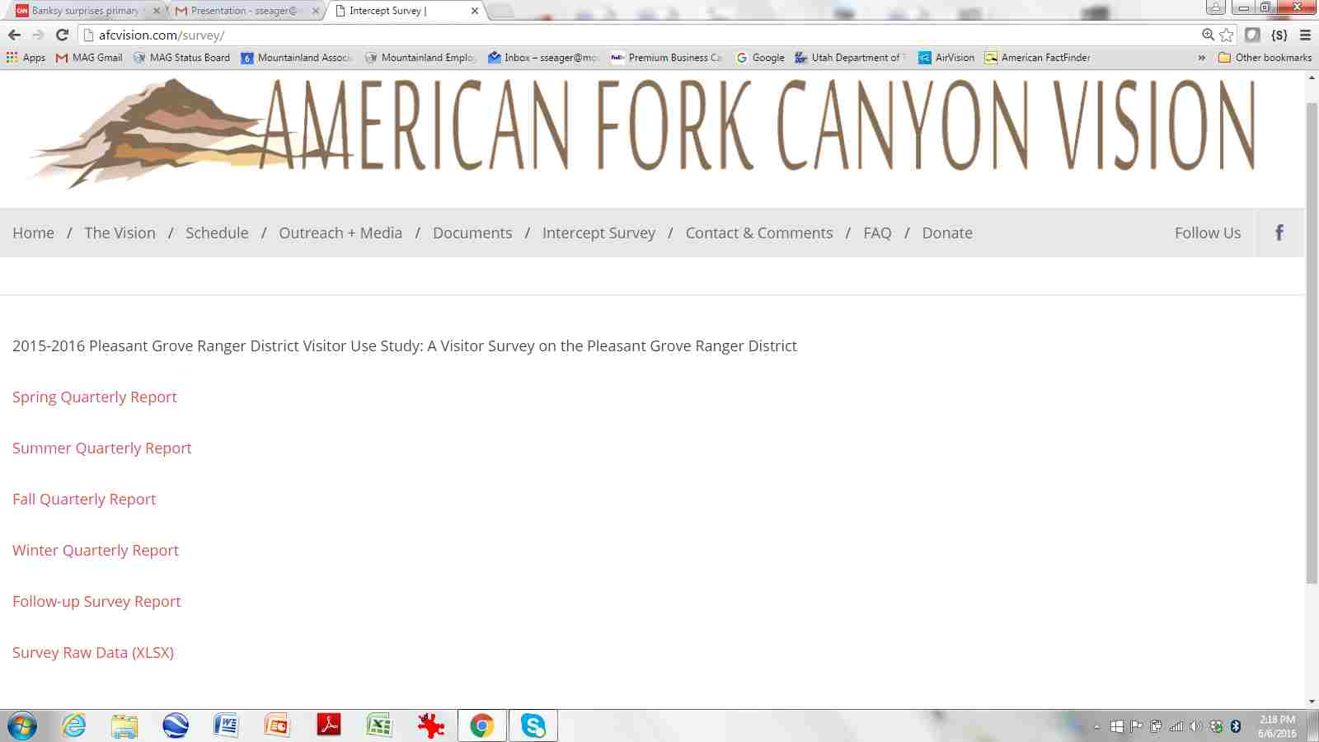

Slide 71


Pleasant Grove Visitor Use Study
Steven Burr, Ph.D. Chase C. Lamborn, M.S.
Recreation Resources Management Research Associate
Extension Specialist Institute of Outdoor Recreation
Outdoor Recreation and Tourism and Tourism
Department of Environment and Society Phone: 801-856-7476
College of Natural Resources E-mail: chase.lamborn@usu.edu
Utah State University
125 W 200 S | Moab, UT 84532
Office: (435) 797-5120
E-mail: steve.burr@usu.edu
Visit the IORT Website at: extension.usu.edu/iort

